Slide 1
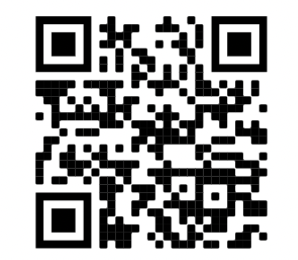
LECTURE 2
Control, NumPy

Slide 2
Announcements
Lab Parties instead of OH!
Two times a week
2 hours
Breakout rooms for each section
Form for better hours for Lab Parties
First one tomorrow since no OH today (Friday [time])
Happy to schedule OH!
Email either Danny or Tina with three availabilities
10 to 20 minutes sessions
Lab 1 grades
Notes:
Make sure to submit to get grade

Slide 3
Booleans

Slide 4
Booleans
A boolean value is either True or False
Boolean expressions uses comparison operators or logical operators

Slide 5
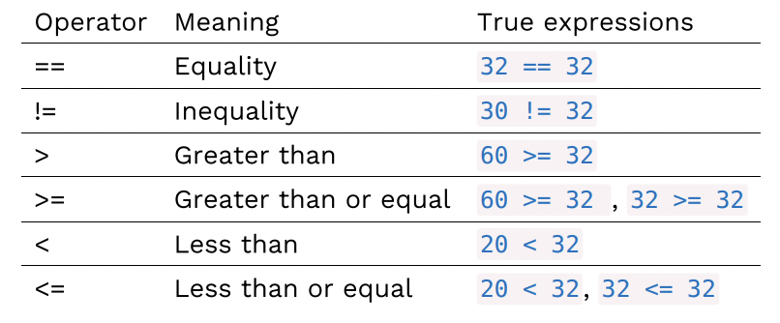
Comparison Operator

Slide 6
Discussion
44 == 22
22 != 32
2 < -1
4 >= 4
8 >= -9
Notes:
False
True
False
True
true

Slide 7
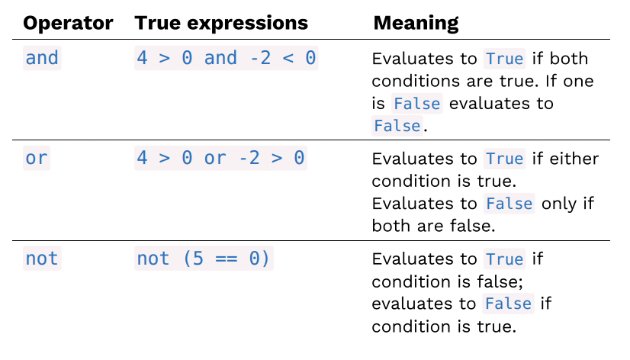
Logical Operator

Slide 8
Discussion
44 == 22 or 32 != 32
3 <= 6 and 2 > -5
not (2 == 2)
3 != 2 and 4 >= -4
not (8 > 1)
Notes:
False
True
False
True
False

Slide 9
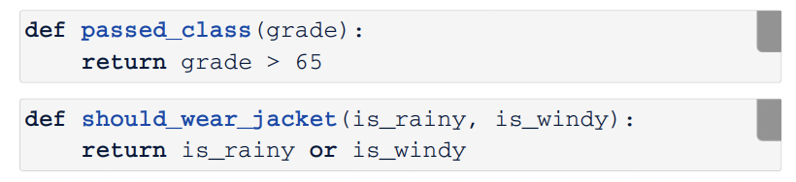
Booleans in Functions
(Demo)

Slide 10
Conditionals

Slide 11
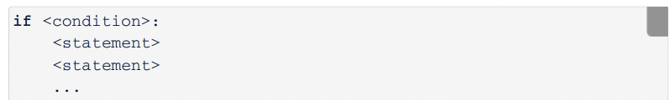
Conditional Statement
Conditional statement executes a suite of code if the statement is true

Slide 12
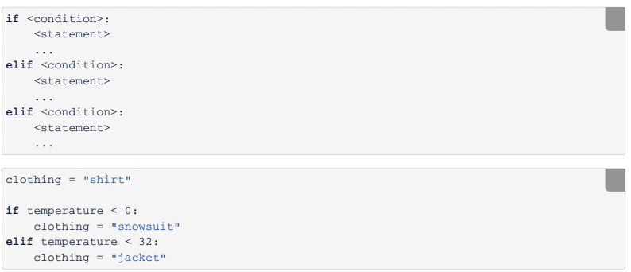
Compound Conditionals
Conditional statements can include any number of elif statements

Slide 13
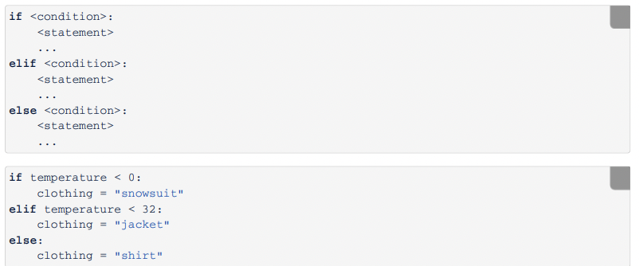
Else Statement
else specify code to execute if none of the previous conditions are true

Slide 14
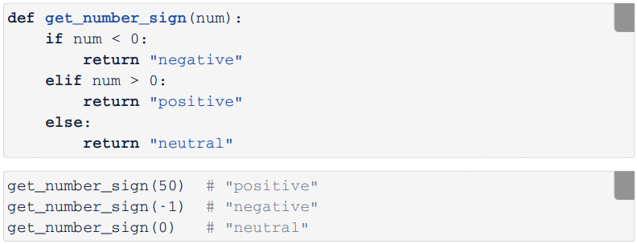
Conditionals in Functions

Slide 15
Summary
Always start with if
Zero or more elif clauses
Zero or one else clauses at the end
(Demo)

Slide 16
NumPy
Notes:
Packages are code that someone else has written that are not in Python
Use tools within the packages so you don’t have to write your own

Slide 17
Arrays
NumPy is a Python package for computing arrays
Arrays contain a sequence of values
All elements must be the same type
Arithmetic is applied to each element individually
(Demo)

Slide 18
Ranges
A range is an array with consecutive numbers
np.arange(end)
An array of increasing ints from 0 to end
np.arange(start, end)
An array of increasing ints from start to end
np.arange(start, end, step)
An array with step between the consecutive values
(Demo)
Notes:
Arange ⇒ array range of numbers

Slide 19
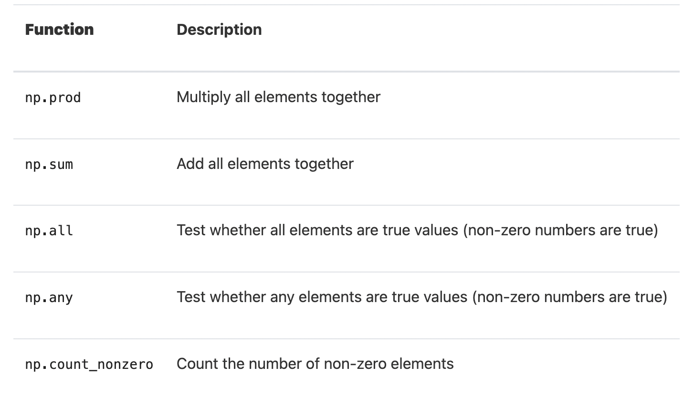
Functions on Array
These functions returns a single value
(Demo)

Slide 20
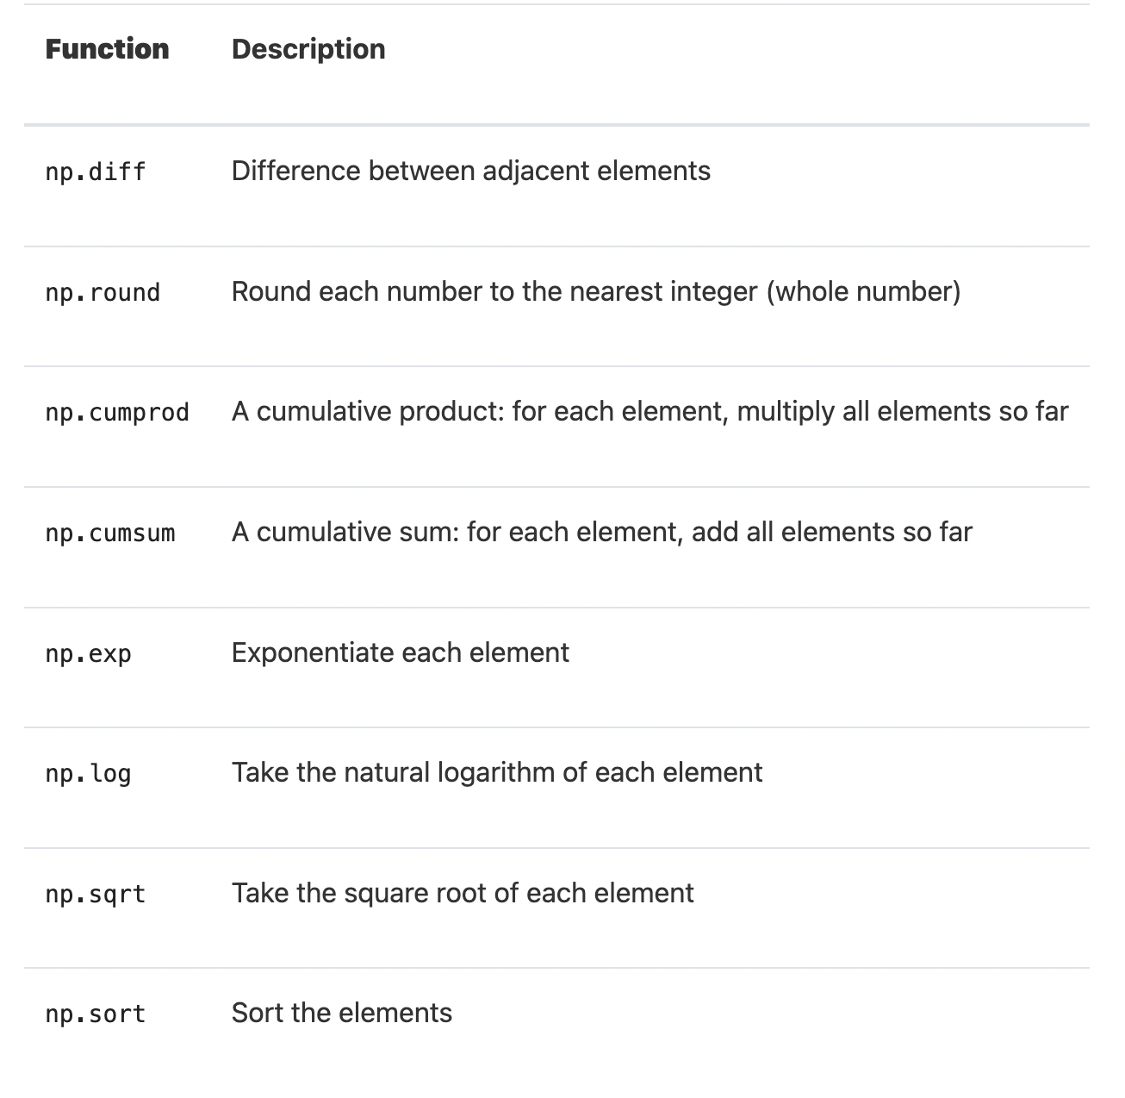
Functions on Array
These functions returns an array
(Demo)

Slide 21
Array Manipulation
np.append(arr, value)
Adds value to the end of the arr
np.insert(arr, index, value)
Inserts value to the index of the arr
np.delete(arr, index)
Deletes the element at index of the arr
*Creates a new array (make sure to reassign if you want it to equal the same variable name)
(Demo)

Slide 22
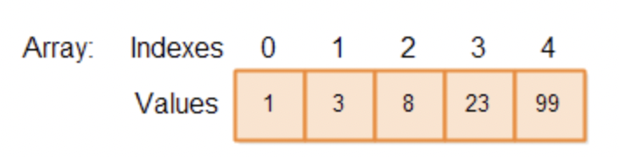
Index and Length
Start at the 0th index and increases in increments of one
len(arr)
Returns the size of arr
(Demo)

Slide 23
Iteration

Slide 24
For Loops
An iterator is an object that provides sequential access to values, one by one
An array is an iterable object
A for statement is an iteration
(Demo)

